Slide 1
Risk Management

Slide 2
Introduction to Risk and Risk Management
Risk is defined as a future negative consequence which is a possibility of suffering loss signifying the impact on the software might result in increased production cost, development of poor-quality software package, not having the ability to finish the project on time.
Risk is managed by different strategies i.e. reactive and proactive.

Slide 3
Reactive Risk Strategies: A reactive strategy may be a risk management strategy monitors the project for seemingly risks for taking corrective actions once necessary.
It is typically perceived because the “lowest” or most simple variety of risk management and is principally propagated because it is related to aviation safety programs that area unit early in implementation; not terribly developed safety program and lack of safety culture.
These forms of risk area unit usually underdeveloped risk and area unit vital for brand spanking new safety programs. Programs while not sturdy reactive risk management ways area unit exposed to considerable risk. These risks area unit applied once risk happens.
The essential component of reactive risk space area unit as follows:
Mitigating safety events when hazard has occurred.
Minimizing damage from critical situation.
Acting quickly and with efficiency in response to undesirable incidents.
Decision making in concern with threats, risk, etc. safety.

Slide 4
Proactive Risk Strategies: A proactive strategy begins at the initial state as technical work is initiated to identify potential risks and assess their probability and impact to rank the risk by its importance.
Proactive risk management is commonly applied in anticipation of risk.
The primary goals of proactive risk management are as follows:
Identify behaviors that cause hazard incidence and stop it before it happens;
Identify root causes before they cause hazard occurrence; and
Understand safety “inputs” which helps in underlying causes that lead to safety performance.

Slide 5
Risk management
Risk management is a software engineering practice with processes, methods and tools for managing risk in a project.
It provides a disciplined environment for proactive decision making by providing access continuously what can go wrong, determining what risks are important to deal with and implementing strategies to deal with those risks.

Slide 6
Risk management includes the following steps during risk resolving:
Risk Identification: It helps in identifying the risk.
Risk Analysis: It helps in understanding the occurrence of risk, its impact and time of occurrence.
Risk Assessment: It is measured in terms of probability of occurrence, loss and risk exposure.
Risk Planning for Resolution: It deals with risk in terms of strategies and execution.
Risk Monitoring: It monitors the risk for its occurrence, impact and implication until it is resolved.
Risk Mitigation: It helps to meet the challenges of risk occurrence in effective implementation.

Slide 7
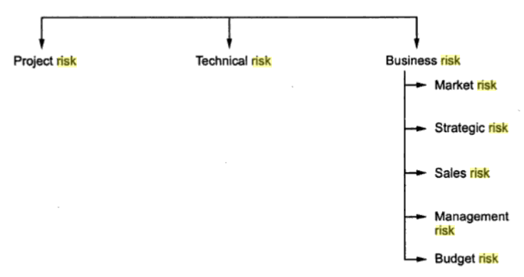
SOFTWARE RISK
Software risk is defined as a measure of the chance of the risk occurrence and the loss due to its exposure.

Slide 8
Types of Risk
Project Risk
Technical Risk
Business Risk
Project Risks: Project risk is mainly concerned with different sorts of monetary fund, schedule, staffing, resource and customer-related issues. Since computer code is intangible, it’s terribly tough to observe and management a computer code project i.e. it’s terribly tough to manage one thing that is not visible to a naked eye and cannot be seen.
Technical Risks: Technical risk is concerned with potential style, implementation, interfacing, testing and maintenance issues. It is the degree of uncertainty between the actual and optimal design solutions. It mainly impacts on the quality and timeline of the project.

Slide 9
Business Risks: Business risk is a future possible risk that may prevent from achieving business goals. It includes the strategies that help in controlling business plans.
The various types of business risks are defined as:
Market Risk : It aims at building an excellent product or system that no one really wants.
Strategic Risk : It aims at building a product that no longer fits into the overall business strategy for the Company.
Sales Risk : It aims at building a product that the sales force doesn’t understand how to sell.
Management Risk : It aims at losing the support of senior management due to change in focus or a change in people.
Budget risk : It aims at losing budgetary or personnel commitment.

Slide 10
According to Charette, risk is categorized in the following three categories:
Known risks are the risks which are identified prior during the identification of project specification and analysis of the scope and definition. They are thoroughly analysed by reviewing project plan and the environment in which project is being developed. For example, resources required for development, tools and techniques needed, lack of problem domain knowledge, expected delivery date etc.
Predictable risks are those which are foreseeable/expected and extrapolated from past project experience. For example, staff turnover, stakeholder communication, support and maintenance of the project etc.
Unpredictable risks are unforeseen, unexpected and hard, if not impossible, to identify in advance. For example, change in policies affecting business project etc.

Slide 11
RISK IDENTIFICATION
Risk identification is defined as a process of handling specific inputs that generates a set of output or risk with context to the software proposed to be developed. It is a systematic attempt to specify threats to the project plan which can be achieved by identifying known and predictable risk.
There are two distinct types of risks approaches:
1) Generic risk identification which includes potential threat identification to a software project.
2) Product-specific risk identification which includes threat identification specific to a product with clear knowledge of technology, people and the environment which are specific to the software.

Slide 12
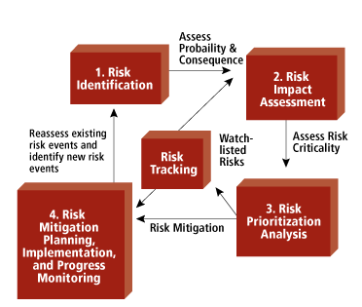

Slide 13
RISK PROJECTION
Risk projection, is also called risk estimation which attempts to rate each risk as likelihood or probability that the risk is real and the consequences of the problems associated with the risk, should it occur.
The project planner, managers and technical staff performs four different risk projection activities, which helps to prioritize the risk which helps in easy allocation of resources for handling them. These are as follows:
(1) It establishes a scale that reflects the perceived likelihood of a risk.
(2) It outlines the consequences of the risk.
(3) It estimates the impact of the risk on the project and the product.
(4) It maintains the overall accuracy of the risk projection in order to have clear understanding of the software.

Slide 14
While assessing the risks impact three factors are considered – nature of risk, scope of the risk and timing at which risk occurs.
The nature of the risk indicates the type or kind of risk. The scope of a risk combines the severity of the risk. Finally, the timing of a risk determines when and for how long the impact will be felt.
Risk exposure RE can be calculated by the following formula:
Risk Exposure = Probability of occurrence of risk X Cost
For example, Consider a software project with 74% of risk probability in which 20 components were developed from the scratch. Each component has on an average 100 LOC and each LOC have an average cost of $15. Then the risk exposure can be calculated as
Cost = number of components*LOC*cost of each LOC
= 20*100*15 = $30,000
RE=Probability of occurrence of risk * Cost
= 0.74 * 30000 = $22,500.

Slide 15
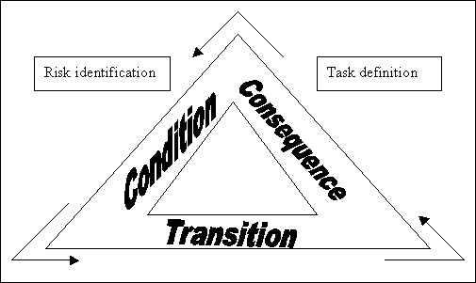
RISK REFINEMENT
Risk refinement is a process of specifying risk into a detailed risk at the later stage for easily mitigating,monitoring and managing it.
David P. Gluch has introduced a CTC format i.e. condition-transition-consequence to be used during the process of risk refinement. It is expressed as current condition, a transition over time, and possible consequences.

Slide 16
Risk Mitigation, Monitoring, and Management(RMMM)
RMMM stands for risk mitigation, monitoring and management, whose main goal is to identify as many potential risks as possible, measure and monitor the severity of risk to suggest resolution strategy by generating a plan.
RMMM is summarized as: Risk Mitigation is a process of risk prevention i.e. it focuses on avoiding the risk to be occurred. Risk Monitoring is a phenomenon of tracking the risk occurred. Risk Management includes contingency plans to be implemented if risk occurs.

Slide 17
RISK MITIGATION
It is the process of strategizing options and actions to enhance opportunities and reduce threats to project objectives and includes tracking identified risks, identifying new risks, and evaluating risk process effectiveness throughout the project.
Following are the steps to be taken for risk mitigation:
  To find the probable risk, it is necessary to communicate the associated staff.
  Before project begins, eliminate all the causes of risk creation.
  Develop a policy beneficial for project development, in case any staff resigns.
  Update the current status of project time to time to continue with project development smoothly.
  Timely maintenance of documents in standard format.
  Periodic reviews can be conducted to monitor the progress of the work.
  Critical activities can be conducted with additional staffing, if required.

Slide 18
RISK MONITORING
Risk monitoring is ongoing activity of risk management. It involves identifying risk and controlling designs by tracking the execution of risk management and continuing to identifying and managing new risks.
It also monitors the execution of planned strategies for the identified risks and evaluates their effectiveness.
Risks needs to be revisited at regular intervals for the team to re-evaluate each risk to determine when new circumstances caused its probability and/or impact to change. At each interval, some risks may be added to the list and others taken away. Risks needs to be reprioritized to have action plans and which move “below the line” and no longer need action plans. Identifying proactive actions is a key to successful risk management owned by individuals and are monitored

Slide 19
Monitoring focuses on the following:
Periodic risk review.
Following policies and procedures.
Cooperation among team members.
Identification of the type of problem occurring.
Implementing a contingency plan
Taking corrective actions
Changing the project objectives

Slide 20
RISK MANAGEMENT
Risk management is a project tracking activity which is carried out throughout the development process to identify, manage and control risks during the development process.
It focuses on risk containment and mitigation. Management starts with identification of plan, and when risk arises it impact is minimized depending upon the experience and knowledge of the entire team.
The primary objectives are to assess whether predicted risks do, in fact, occur and to ensure that the desired actions to minimize risk are properly applied. It collects information that can be used for future risk analysis.
It includes the following activities:
Identify the risks and its cause.
Prioritize all risks.
Create a plan linking each risk to a mitigation.
During the project monitor risk triggers.
In case of risk materialization, implement the mitigating action.
Communicate risk status throughout project.

